Slide 1
Undergrad Research at Iowa
ICRU and U
Fall 2022

Slide 2
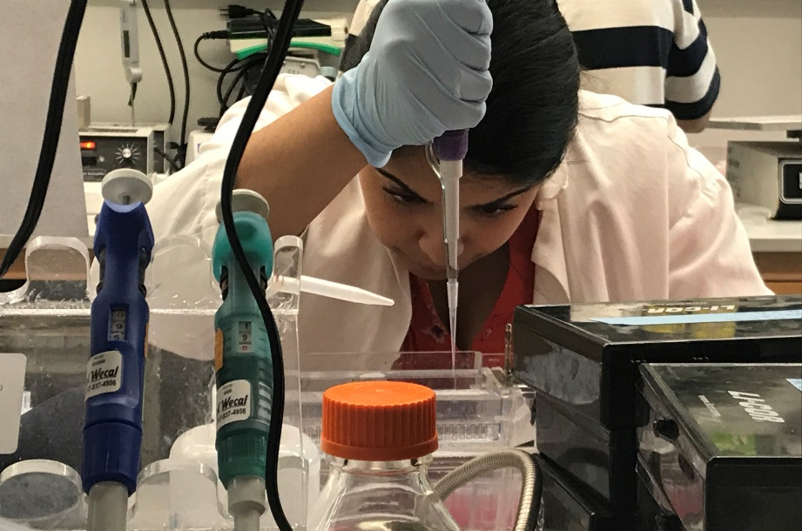
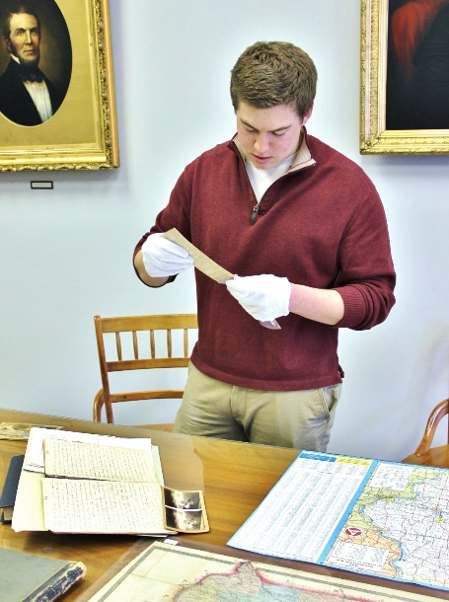
What is “Research”?
Research is Science….
… and NOT science.

Slide 3
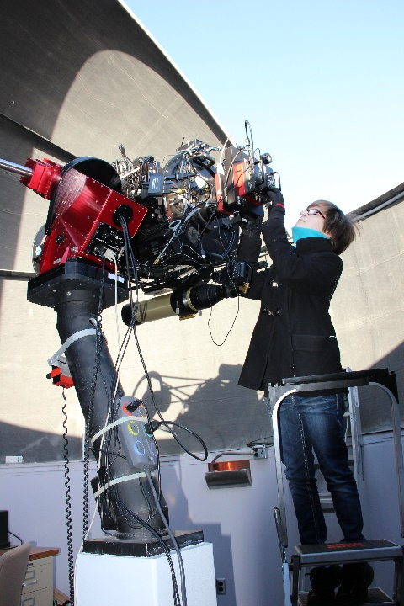
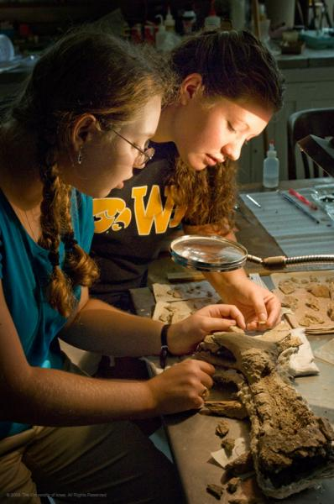
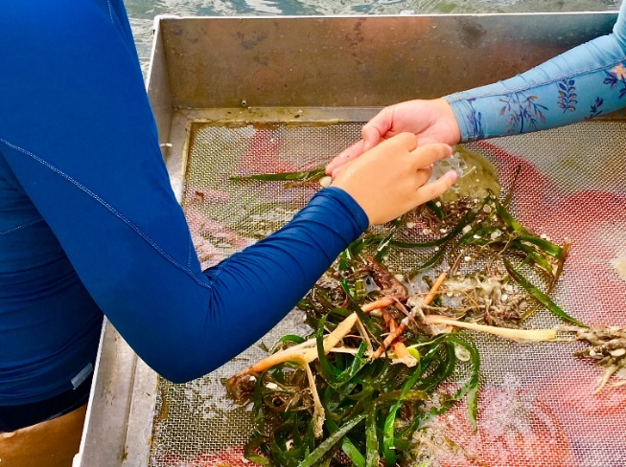
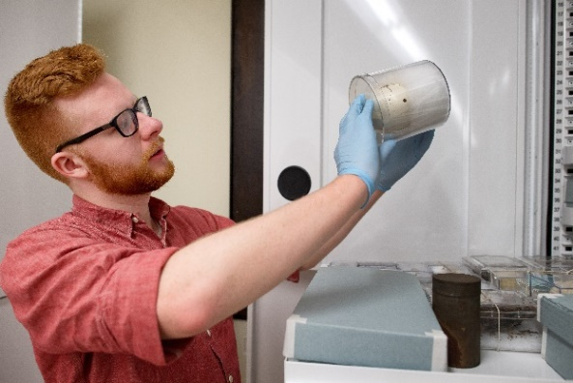
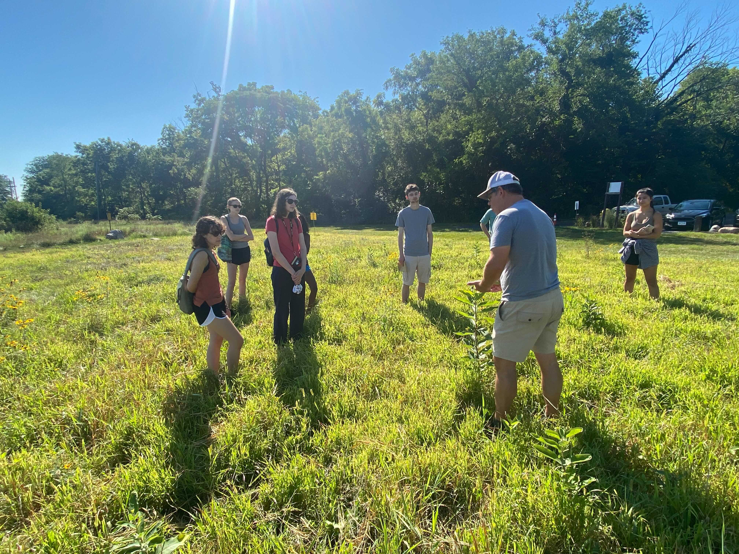
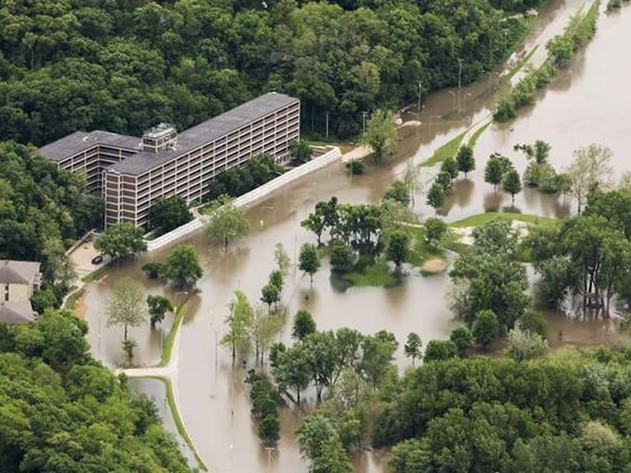
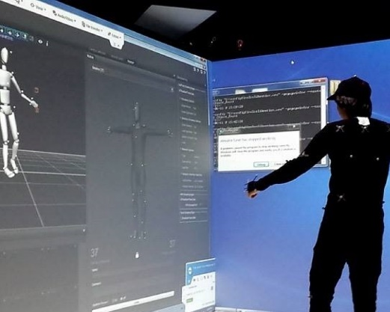
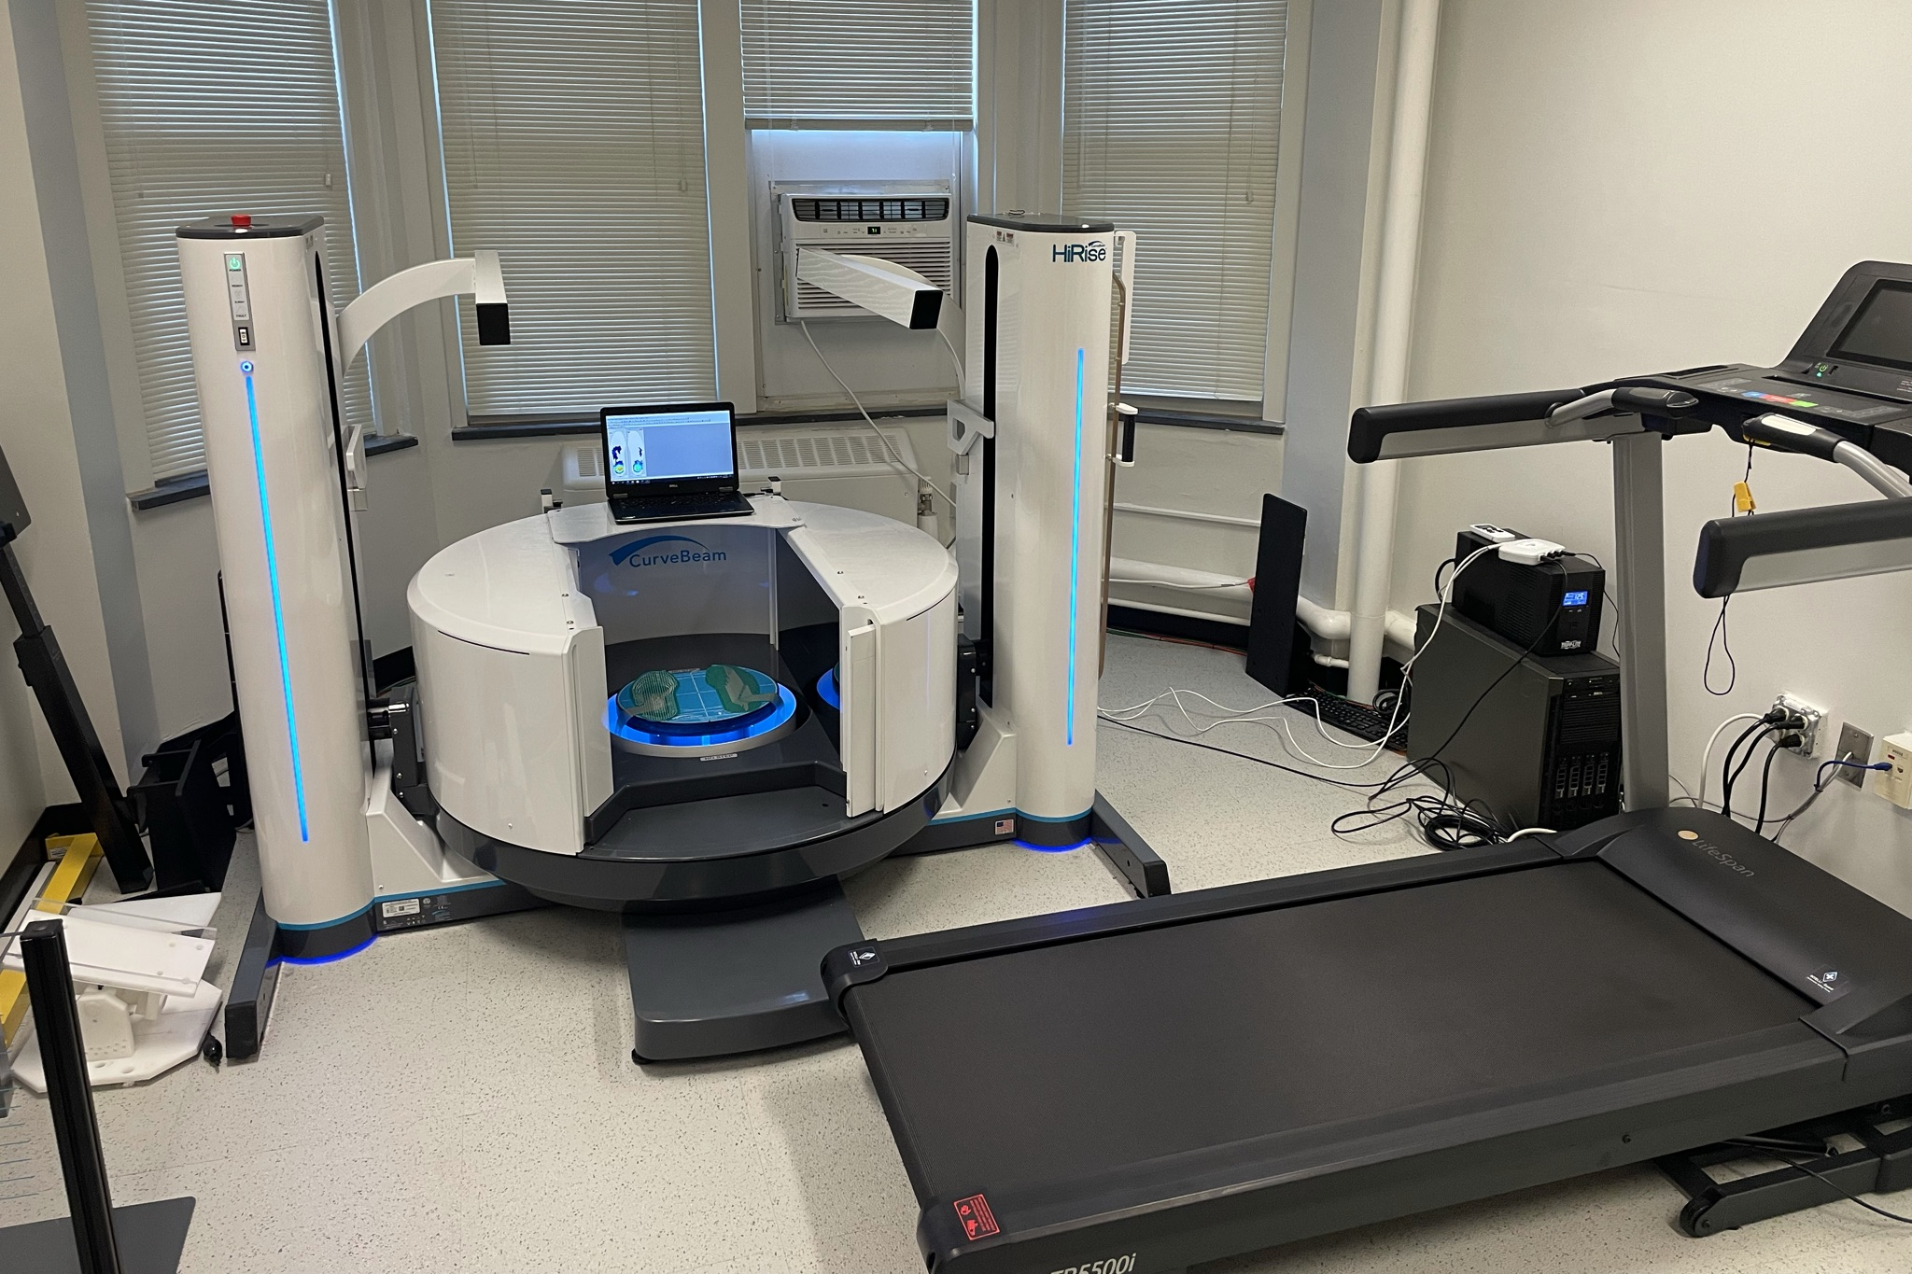
“A mentored investigation or creative inquiry conducted by undergraduates that seeks to make a scholarly or artistic contribution to knowledge.”
– Council on Undergraduate Research

Slide 4
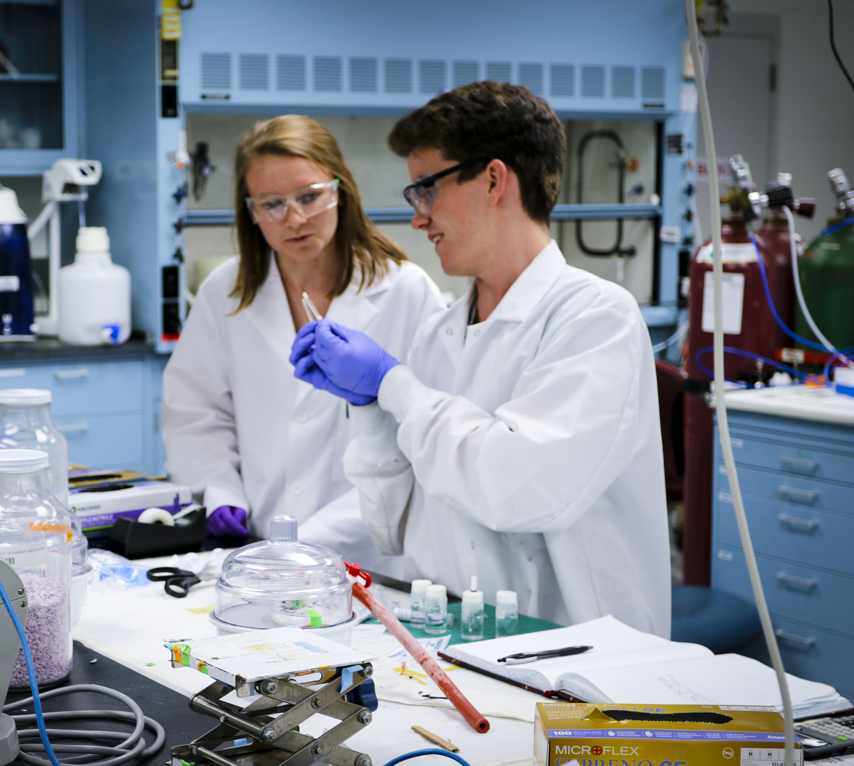
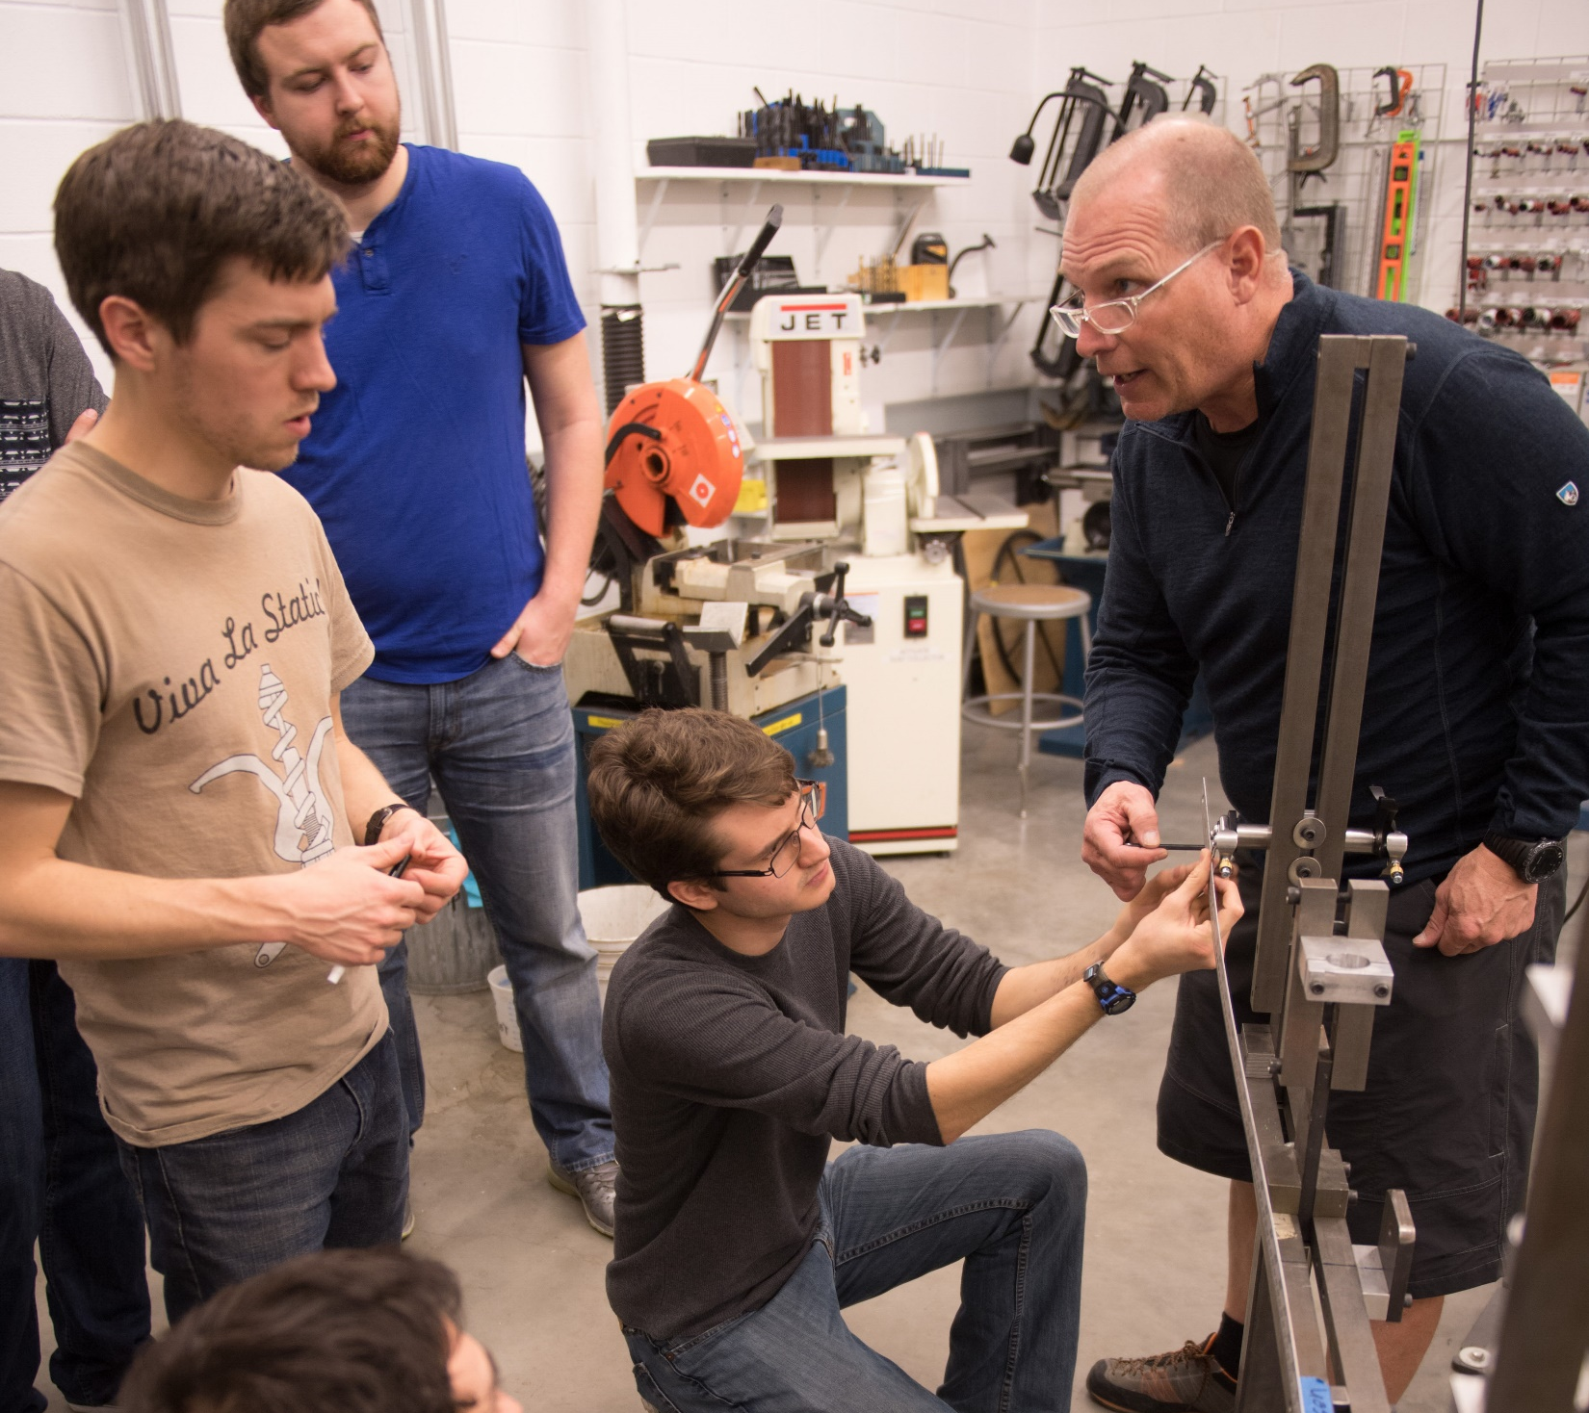
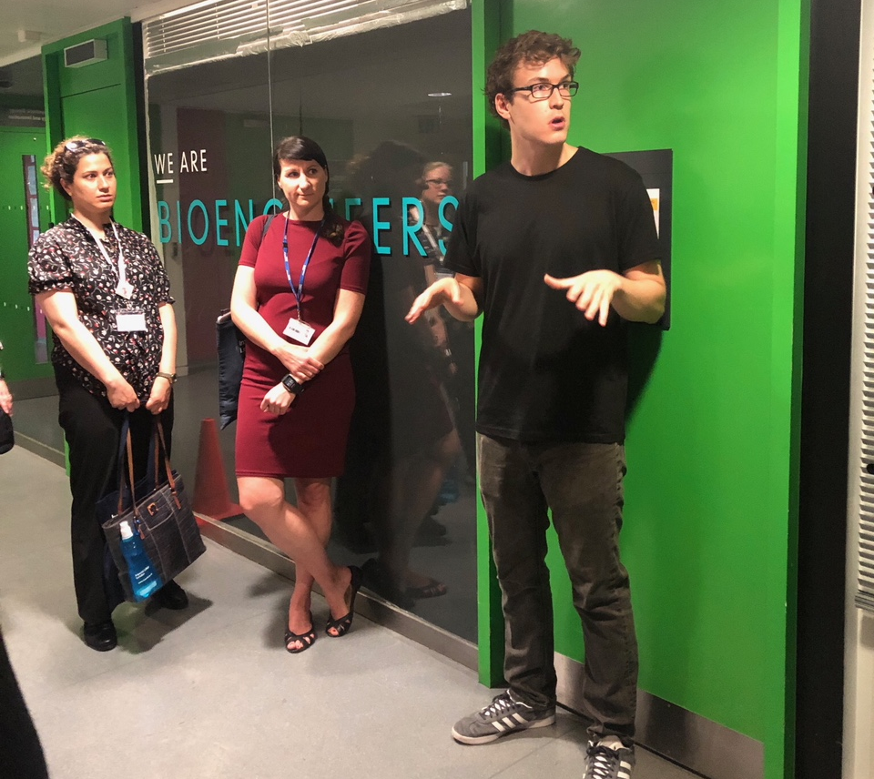
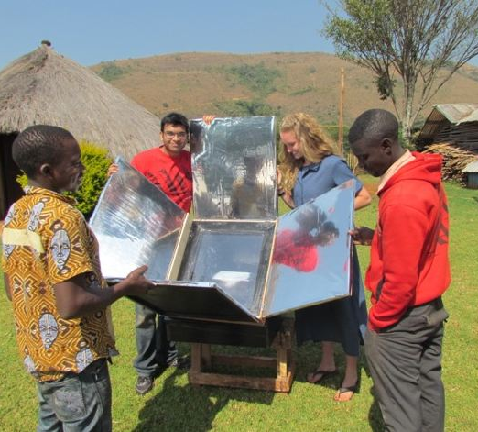
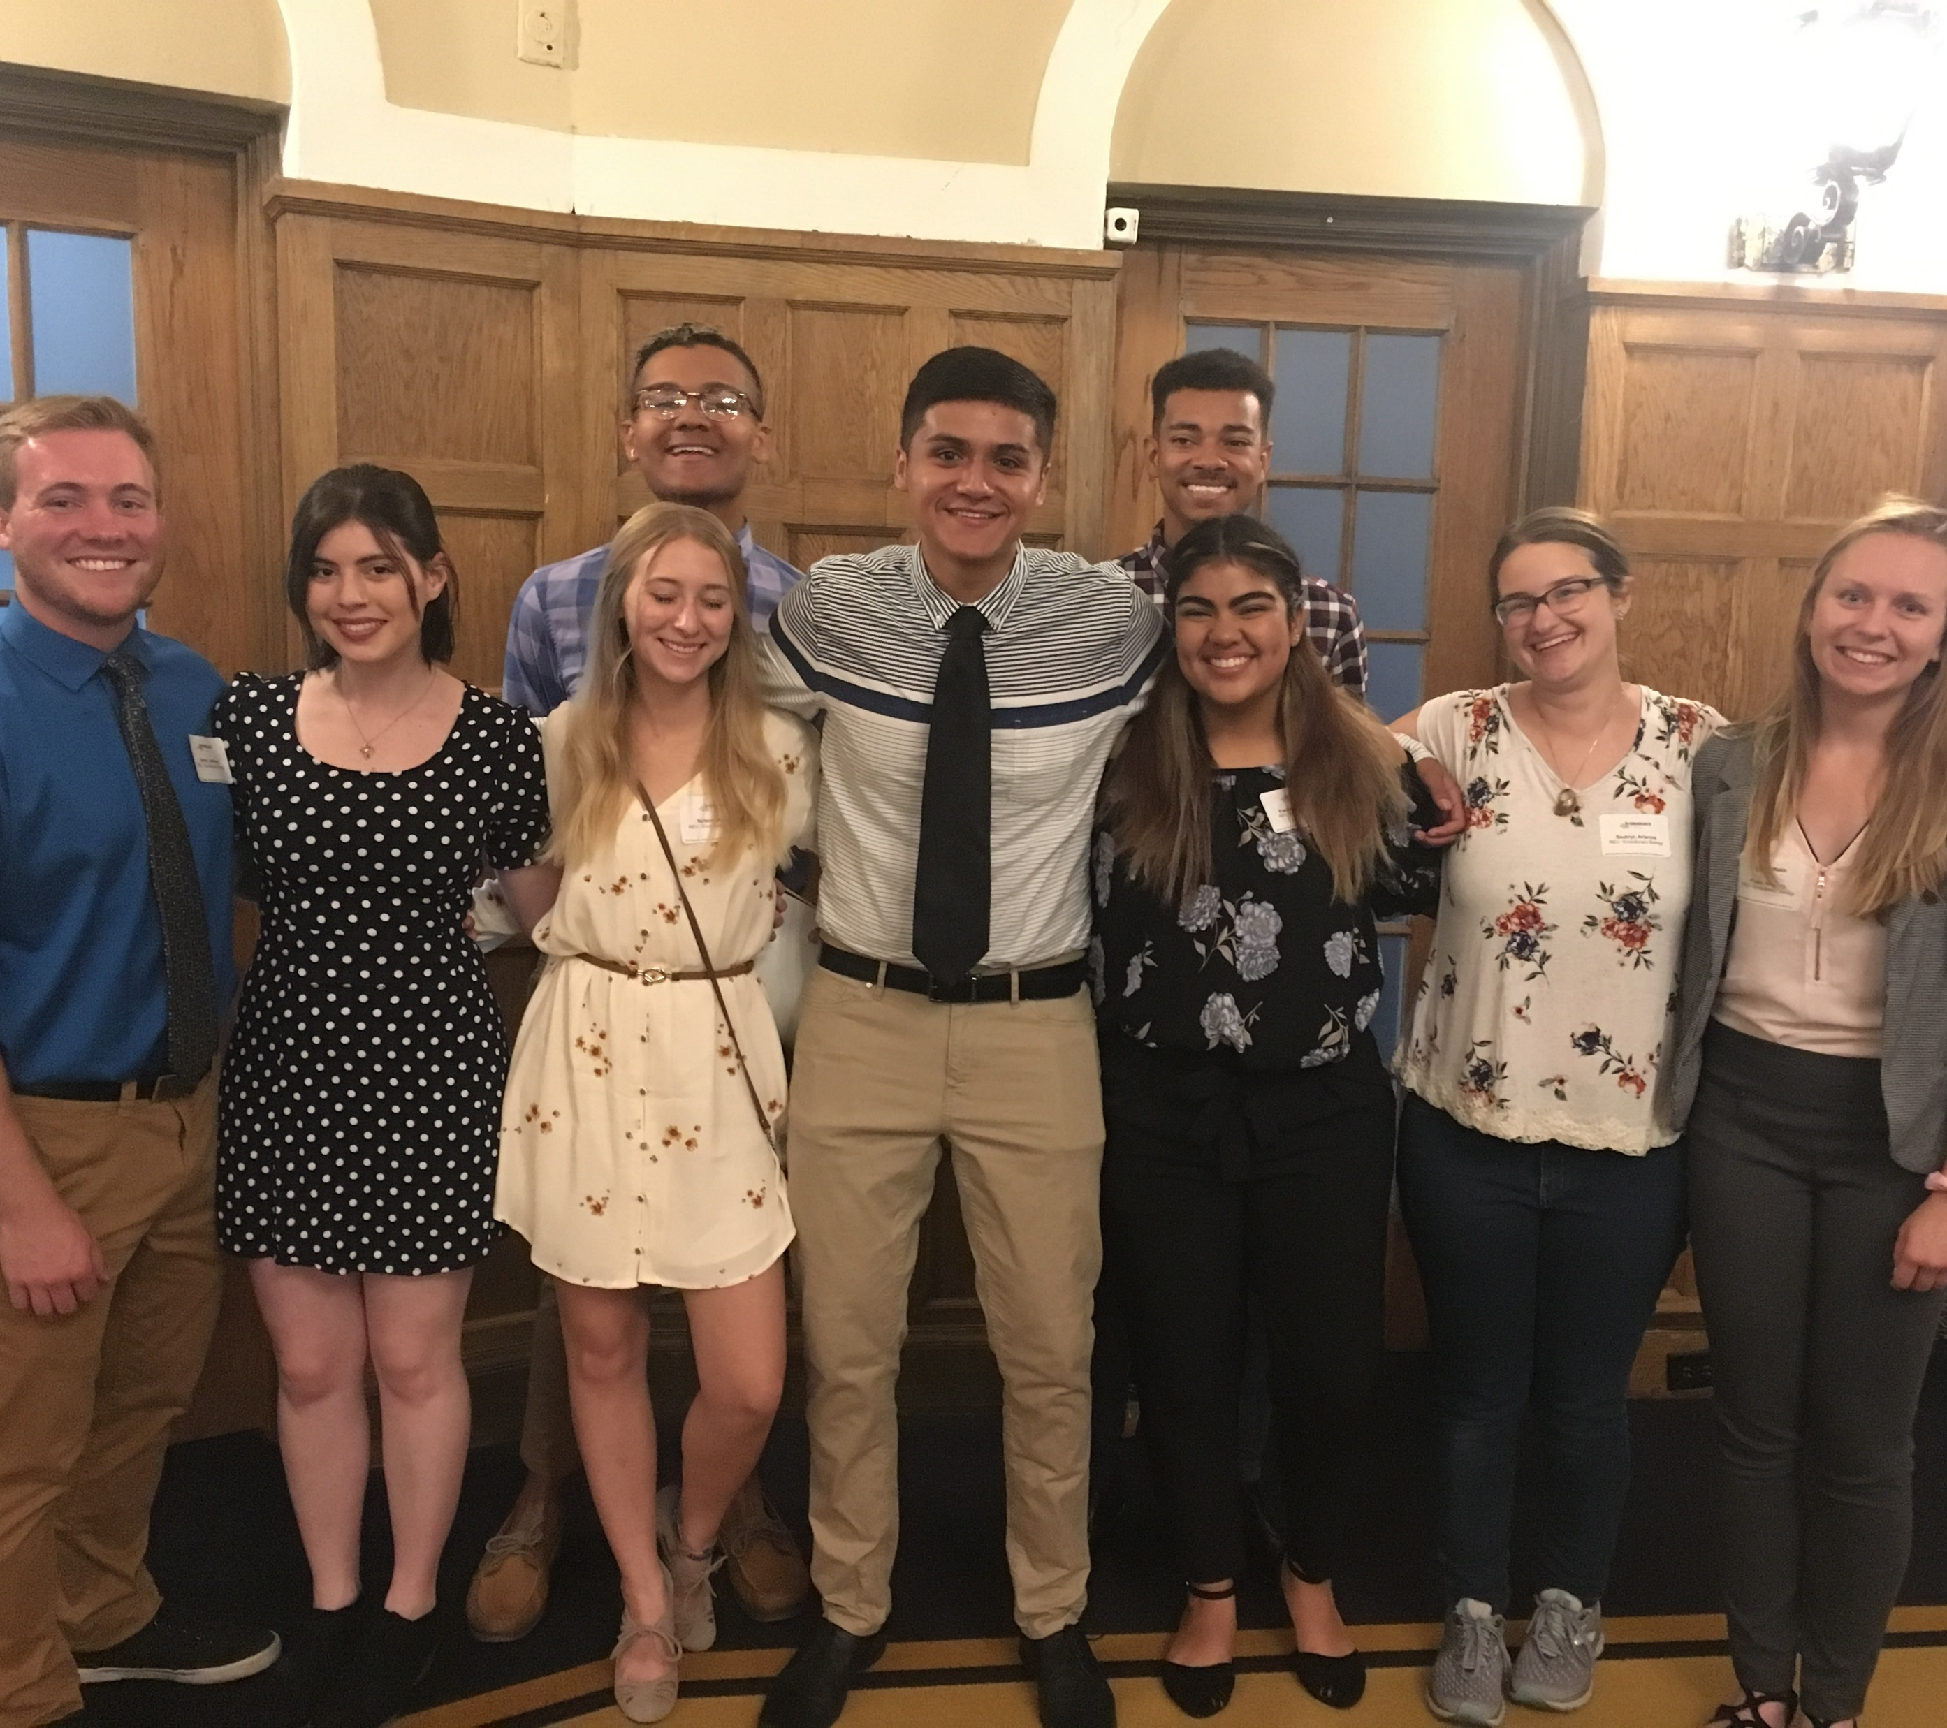
Benefits
Build Relationships
Critical Thinking
Apply Coursework
Explore Career Paths
Practical Experience
Work closely with faculty, staff, and students – on campus and off.
Develop problem solving skills and resilience.
Understand why you learn what you learn.
Figure out what you want to be and where you want to go.
Hands-on, real-life skills, from communication to project management.

Slide 5
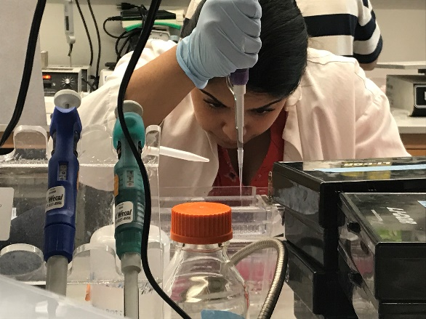
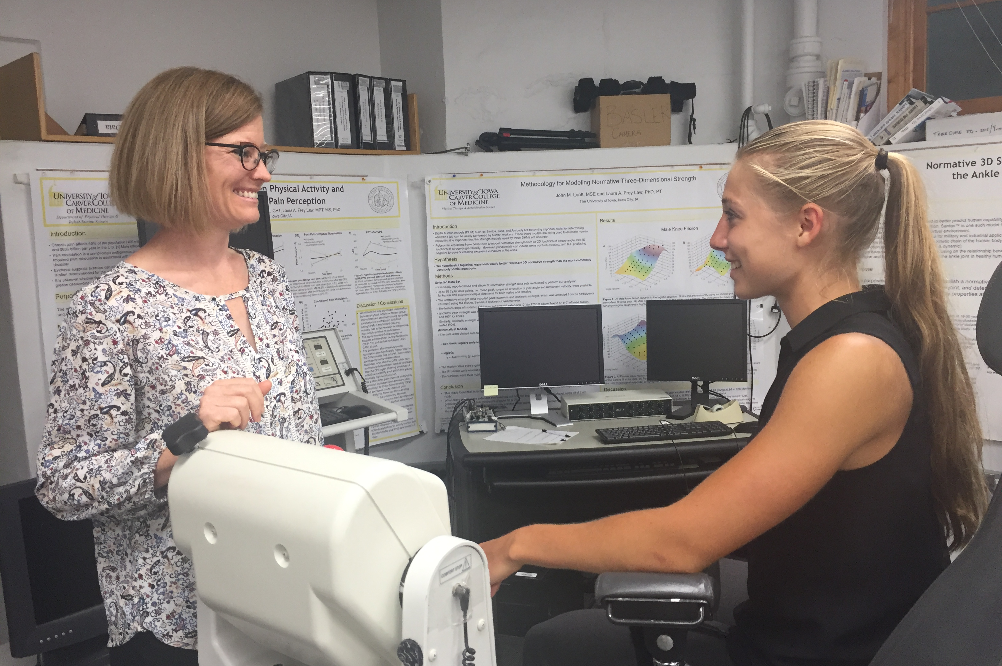
Contact ICRU about:
Finding Mentors and Programs
Professional Development
Course Credit
Funding Options
Work with students to identify and contact potential research mentors and other programs, like summer experiences
Host annual events:
Marshall Undergrad Research Conference
Fall Undergraduate Research Festival (Nov 2)
0-4 semester hour opportunities for transcript recognition and graded or ungraded academic credit
Identifying funding opportunities and other compensatory mechanisms

Slide 6
Fall Undergraduate Research Festival (FURF)
Wednesday, Nov 2nd
4:00-6:00 PM
2nd Floor UCC
125+ Presenters
ICRU FURF Link

Slide 7
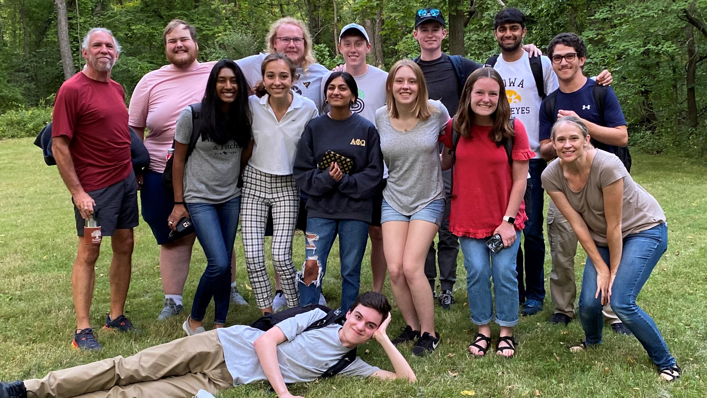
Discover
Ask our Ambassadors!

Slide 8
Questions? Thank you!
icru.research.uiowa.edu

